Slide 1
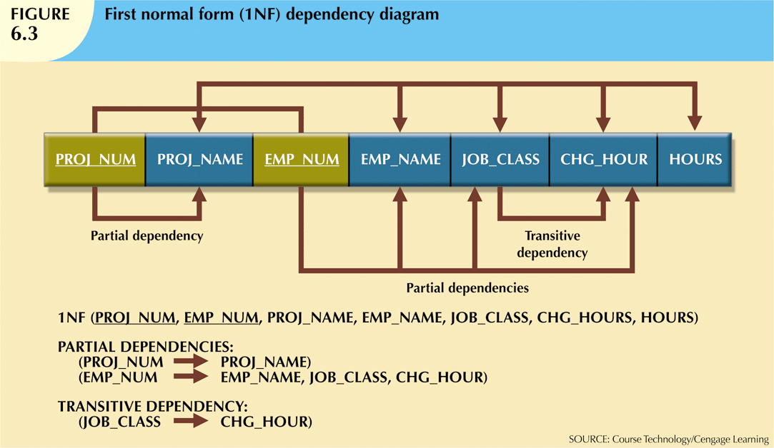
as neither attribute is a prime attribute
Database Systems, 10th Edition

Slide 2
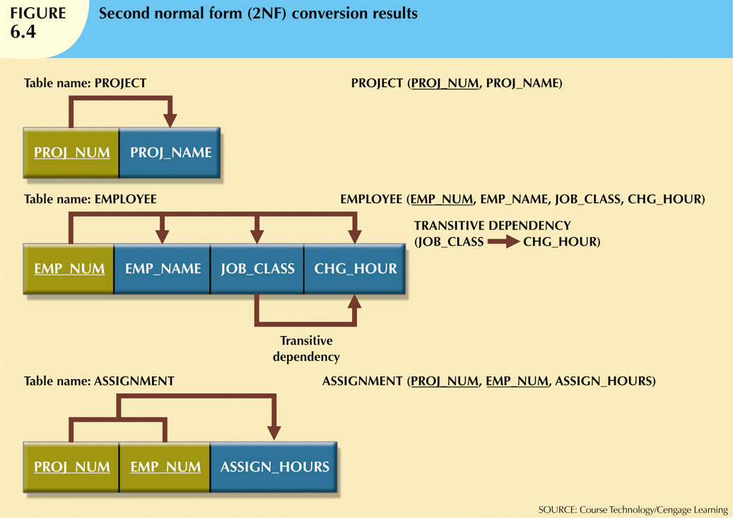
Database Systems, 10th Edition

Slide 3
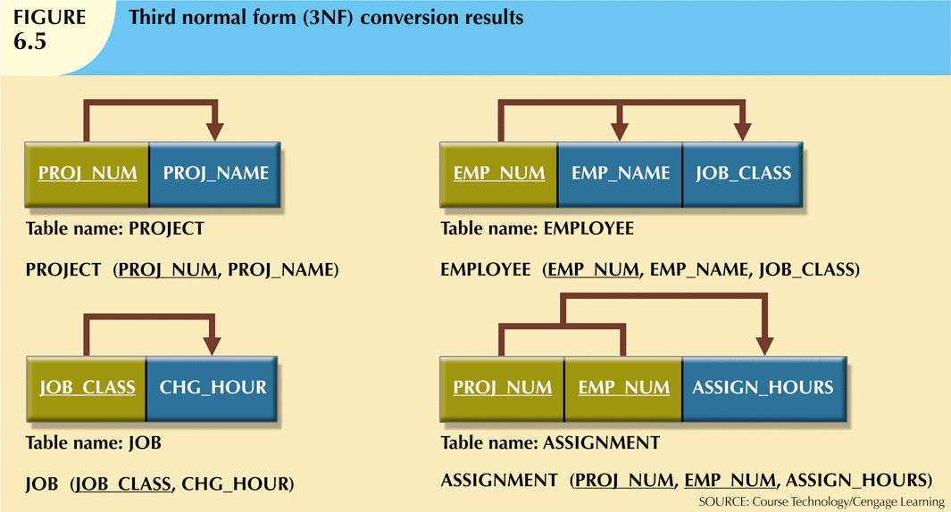
Database Systems, 10th Edition

